Slide 1

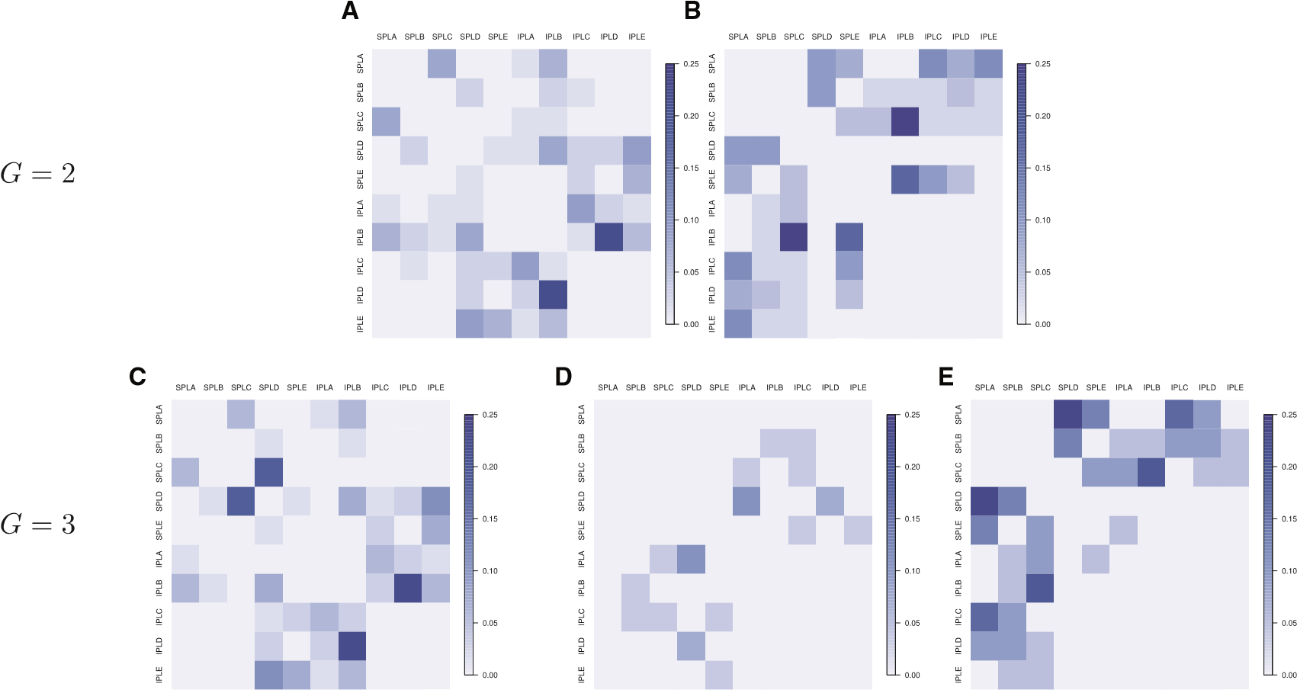
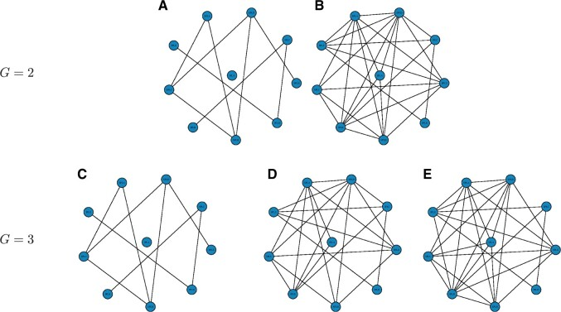


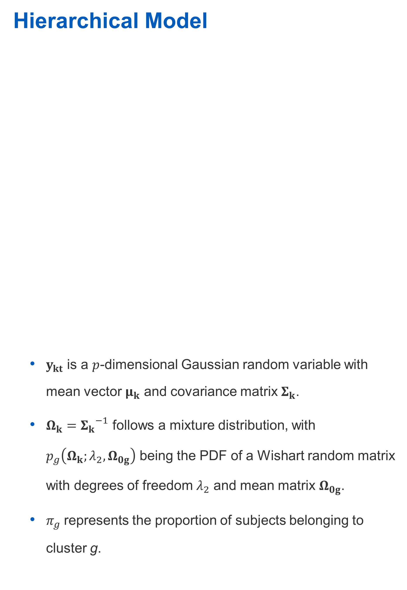
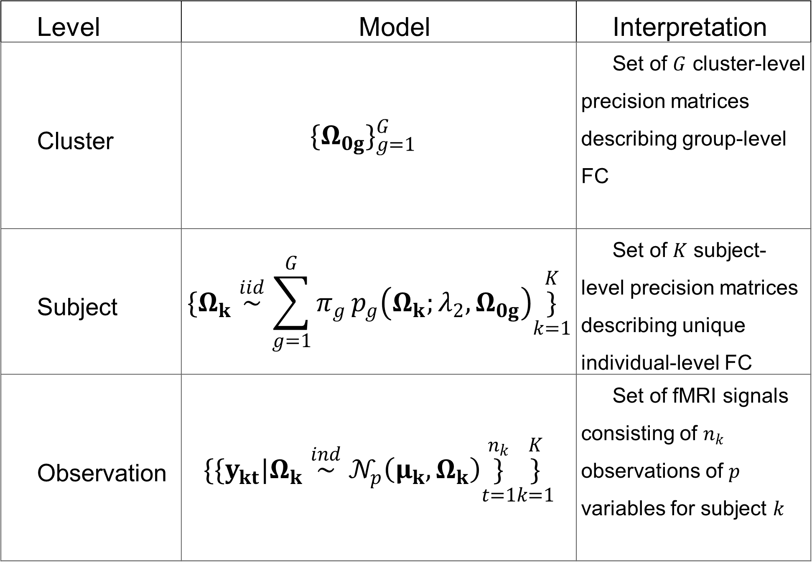
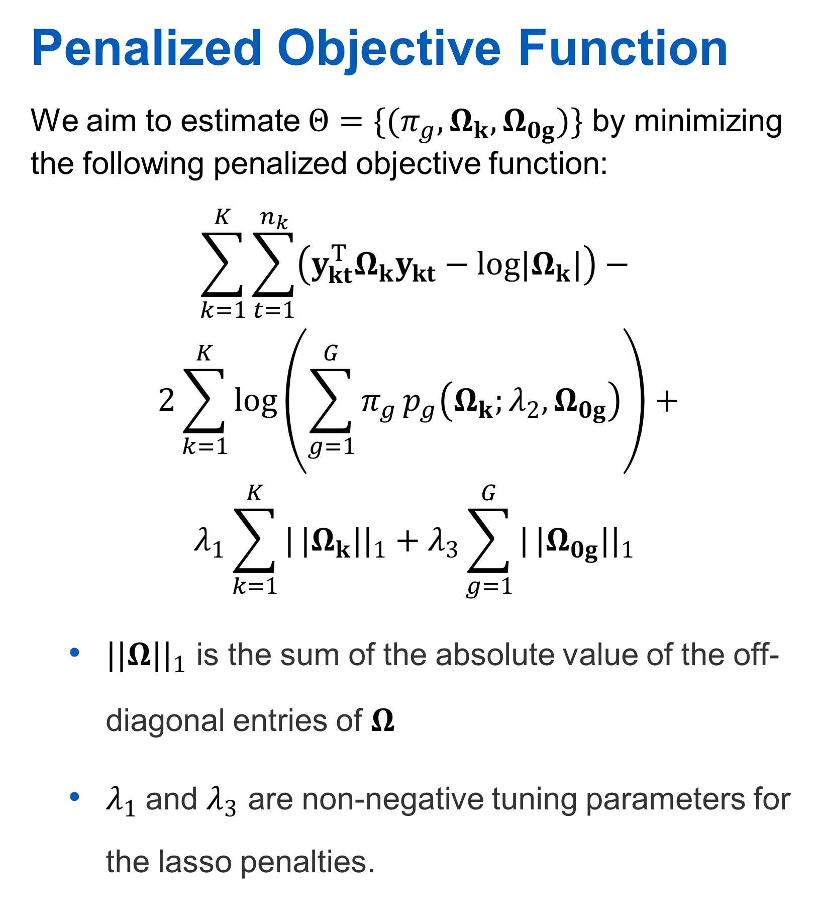
Penalized model-based clustering of fMRI data
Andrew DiLernia¹, Karina Quevedo², Jazmin Camchong², Kelvin Lim², Wei Pan³, and Lin Zhang³
¹Department of Statistics, Grand Valley State University, ²Division of Biostatistics, University of Minnesota
³Department of Psychiatry, University of Minnesota
Introduction
Functional connectivity (FC) is important for understanding neurodegenerative diseases and psychiatric disorders.
FC-based clustering of multi-subject fMRI data can inform physicians about patient diagnoses.
We propose a random covariance clustering model (RCCM) to cluster individuals based on FC, estimate individual FC networks, and to infer shared network features.
Penalized Objective Function
We aim to estimate $Θ=\{(π_{g},Ω_{k},Ω_{0g})\}$ by minimizing the following penalized objective function:
$$\sum_{k=1}^{K}{\sum_{t=1}^{n_{k}}{\left(y_{kt}^{T}Ω_{k}y_{kt}−log|Ω_{k}|\right)−}}$$
$$2\sum_{k=1}^{K}{log}\left(\sum_{g=1}^{G}{π_{g}}p_{g}\left(Ω_{k};λ_{2},Ω_{0g}\right)\right)+$$
$$λ_{1}\sum_{k=1}^{K}{|}|Ω_{k}||_{1}+λ_{3}\sum_{g=1}^{G}{|}|Ω_{0g}||_{1}$$
$||Ω||_{1}$ is the sum of the absolute value of the off-diagonal entries of $Ω$
$λ_{1}$and $λ_{3}$ are non-negative tuning parameters for the lasso penalties.
Data Analysis
We applied the RCCM to a resting-state fMRI data set collected on 40 participants with chronic-episode schizophrenic, 21 first-episode schizophrenic participants, and 43 healthy controls.
Variability in edge presence for G = 2 or 3 clusters. A value of 0 indicates perfect agreement in edge presence within a cluster, while a value closer to 0.25 indicates more heterogeneity in edge presence.
Estimated FC networks of the inferior and superior parietal lobules obtained using RCCM specifying G = 2 or 3 clusters for the top and bottom rows respectively.
Discussion
Mauris orci mi, varius id diam id, egestas auctor enim. Praesent ut massa nibh. Duis purus neque, facilisis cursus ultrices vel, ullamcorper ac augue. Donec semper lorem:
Sed Risus Nibh: CiIn nisl quam, aliquet sed nibh sitamet, faucibus placerat dui augue scelerisque.
Curabitur Accumsan Nulla: Fusce quis augue urna scelerisque, luctus rum sed, ut dolor in pulvinar in eros.
Elementum Orci Dignissim: Proin semper ipsum finibus quam tempor, vitae consectetur.
Hierarchical Model
$y_{kt}$ is a $p$-dimensional Gaussian random variable with mean vector $μ_{k}$ and covariance matrix $Σ_{k}$.
$Ω_{k}={Σ_{k}}^{−1}$ follows a mixture distribution, with $p_{g}\left(Ω_{k};λ_{2},Ω_{0g}\right)$ being the PDF of a Wishart random matrix with degrees of freedom $λ_{2}$ and mean matrix $Ω_{0g}$.
$π_{g}$ represents the proportion of subjects belonging to cluster g.
Level | Model | Interpretation
Cluster | $$\{Ω_{0g}\}_{g=1}^{G}$$ | Set of $G$ cluster-level precision matrices describing group-level FC
Subject | $$\{Ω_{k}\overset{iid}{∼}\sum_{g=1}^{G}{π_{g}}p_{g}\left(Ω_{k};λ_{2},Ω_{0g}\right)\underset{k=1}{\overset{K}{\}}}$$ | Set of $K$ subject-level precision matrices describing unique individual-level FC
Observation | $$\{\{y_{kt}|Ω_{k}\overset{ind}{∼}𝒩_{p}\left(μ_{k},Ω_{k}\right)\underset{t=1}{\overset{n_{k}}{\}}}\underset{k=1}{\overset{K}{\}}}$$ | Set of fMRI signals consisting of $n_{k}$ observations of $p$ variables for subject $k$
R Package
An R package implementing our method for clustering and joint estimation of multiple sparse precision matrices is publicly available on GitHub: https://github.com/dilernia/rccm
References
Phasellus nec lectus bibendum, posuere nibh id, lacinia magna
Mauris orci mi, varius id diam id, egestas auctor enim
Duis vitae tincidunt tortor, vitae sollicitudin magna
Aenean et est sem. Phasellus nec lectus bibendum, posuere
Lacinia magna. Mauris orci mi, varius id diam id, egestas auctor
Mauris orci mi, varius id diam id, egestas auctor enim
Duis vitae tincidunt tortor, vitae sollicitudin magna
Table 1 - Title
8.01 | 7.99 | 5.77 | 6.44
4.50 | 3.11 | 9.55 | 1.12
6.15 | 8.00 | 6.18 | 5.65
8.21 | 2.16 | 3.11* | 7.17
3.00 | 9.70 | 10.50 | 4.45
*Unamcorper efficitur sed in nulla.
Department of Statistics Grand Valley State University
gvsu.edu

Slide 2
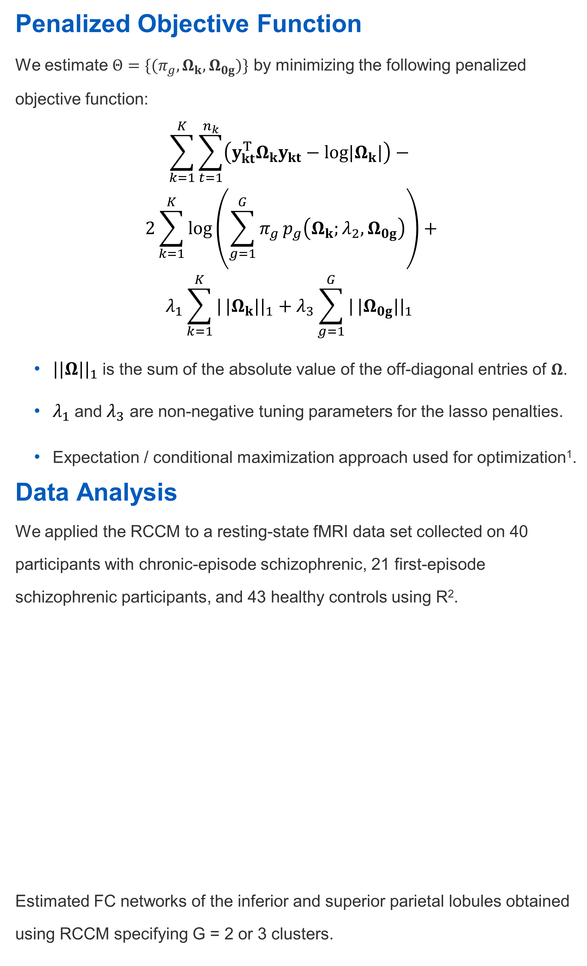
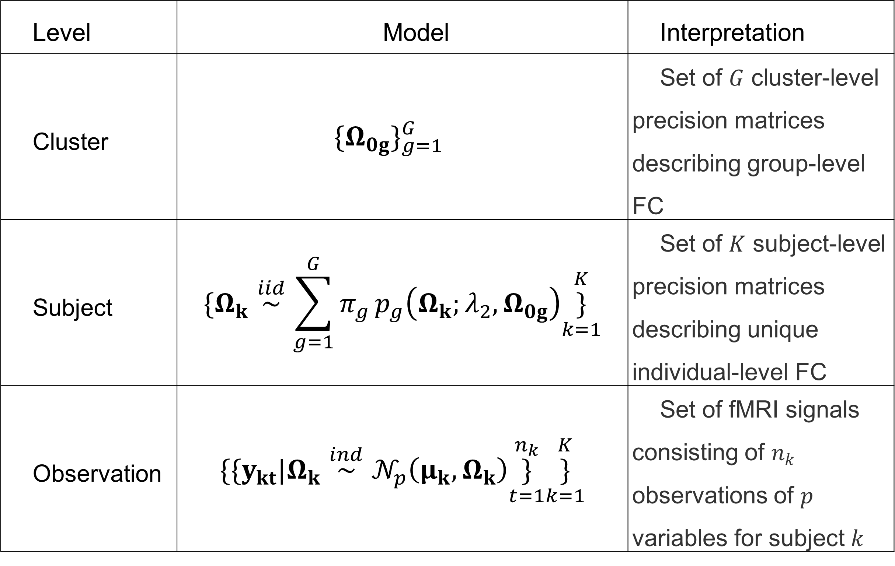
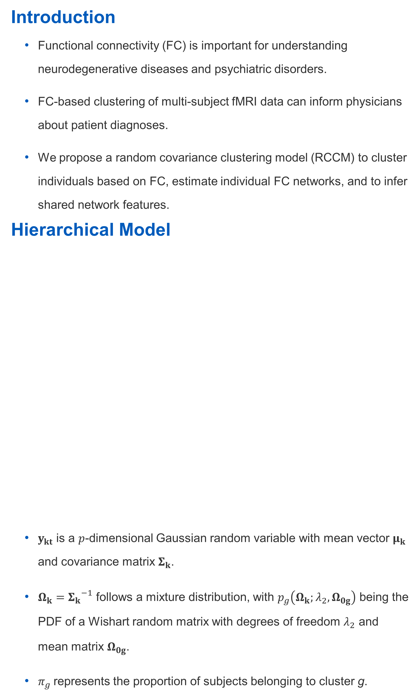
Penalized model-based clustering of fMRI data
Andrew DiLernia¹, Karina Quevedo², Jazmin Camchong², Kelvin Lim², Wei Pan³, and Lin Zhang³
¹Department of Statistics, Grand Valley State University, ²Division of Biostatistics, University of Minnesota
³Department of Psychiatry, University of Minnesota
Introduction
Functional connectivity (FC) is important for understanding neurodegenerative diseases and psychiatric disorders.
FC-based clustering of multi-subject fMRI data can inform physicians about patient diagnoses.
We propose a random covariance clustering model (RCCM) to cluster individuals based on FC, estimate individual FC networks, and to infer shared network features.
Hierarchical Model
$y_{kt}$ is a $p$-dimensional Gaussian random variable with mean vector $μ_{k}$ and covariance matrix $Σ_{k}$.
$Ω_{k}={Σ_{k}}^{−1}$ follows a mixture distribution, with $p_{g}\left(Ω_{k};λ_{2},Ω_{0g}\right)$ being the PDF of a Wishart random matrix with degrees of freedom $λ_{2}$ and mean matrix $Ω_{0g}$.
$π_{g}$ represents the proportion of subjects belonging to cluster g.
Penalized Objective Function
We estimate $Θ=\{(π_{g},Ω_{k},Ω_{0g})\}$ by minimizing the following penalized objective function:
$$\sum_{k=1}^{K}{\sum_{t=1}^{n_{k}}{\left(y_{kt}^{T}Ω_{k}y_{kt}−log|Ω_{k}|\right)−}}$$
$$2\sum_{k=1}^{K}{log}\left(\sum_{g=1}^{G}{π_{g}}p_{g}\left(Ω_{k};λ_{2},Ω_{0g}\right)\right)+$$
$$λ_{1}\sum_{k=1}^{K}{|}|Ω_{k}||_{1}+λ_{3}\sum_{g=1}^{G}{|}|Ω_{0g}||_{1}$$
$||Ω||_{1}$ is the sum of the absolute value of the off-diagonal entries of $Ω$.
$λ_{1}$and $λ_{3}$ are non-negative tuning parameters for the lasso penalties.
Expectation / conditional maximization approach used for optimization¹.
Data Analysis
We applied the RCCM to a resting-state fMRI data set collected on 40 participants with chronic-episode schizophrenic, 21 first-episode schizophrenic participants, and 43 healthy controls using R².
Estimated FC networks of the inferior and superior parietal lobules obtained using RCCM specifying G = 2 or 3 clusters.
Variability in edge presence for G = 2 or 3 clusters. A value of 0 indicates perfect agreement in edge presence within a cluster, while a value closer to 0.25 indicates more heterogeneity in edge presence.
Discussion
Found some evidence to support the disconnection hypothesis among the majority schizophrenic group.
RCCM could be extended to account for autocorrelation in fMRI or to allow for dynamic FC
R Package
An R package implementing our method for clustering and joint estimation of multiple sparse precision matrices is publicly available on GitHub: https://github.com/dilernia/rccm
References
Meng, X., and D. B. Rubin. 1993. “Maximum Likelihood Estimation via the ECM Algorithm: A General Framework.” Biometrika 80 (2): 267. https://doi.org/10.2307/2337198.
R Core Team. 2021. R: A Language and Environment for Statistical Computing. Vienna, Austria: R Foundation for Statistical Computing. https://www.R-project.org/.
G | Group | Control | 1st Episode | Chronic | G
2 | A | 23 (53.5%) | 14 (66.7%) | 30 (75.0%) | 2
 | B | 20 (46.5%) | 7 (33.3%) | 10 (25.0%)
3 | C | 21 (48.8%) | 12 (57.1%) | 28 (70.0%) | 3
 | D | 10 (23.3%) | 6 (28.6%) | 8 (20.0%)
Level | Model | Interpretation
Cluster | $$\{Ω_{0g}\}_{g=1}^{G}$$ | Set of $G$ cluster-level precision matrices describing group-level FC
Subject | $$\{Ω_{k}\overset{iid}{∼}\sum_{g=1}^{G}{π_{g}}p_{g}\left(Ω_{k};λ_{2},Ω_{0g}\right)\underset{k=1}{\overset{K}{\}}}$$ | Set of $K$ subject-level precision matrices describing unique individual-level FC
Observation | $$\{\{y_{kt}|Ω_{k}\overset{ind}{∼}𝒩_{p}\left(μ_{k},Ω_{k}\right)\underset{t=1}{\overset{n_{k}}{\}}}\underset{k=1}{\overset{K}{\}}}$$ | Set of fMRI signals consisting of $n_{k}$ observations of $p$ variables for subject $k$
Department of Statistics Grand Valley State University
gvsu.edu

Slide 3
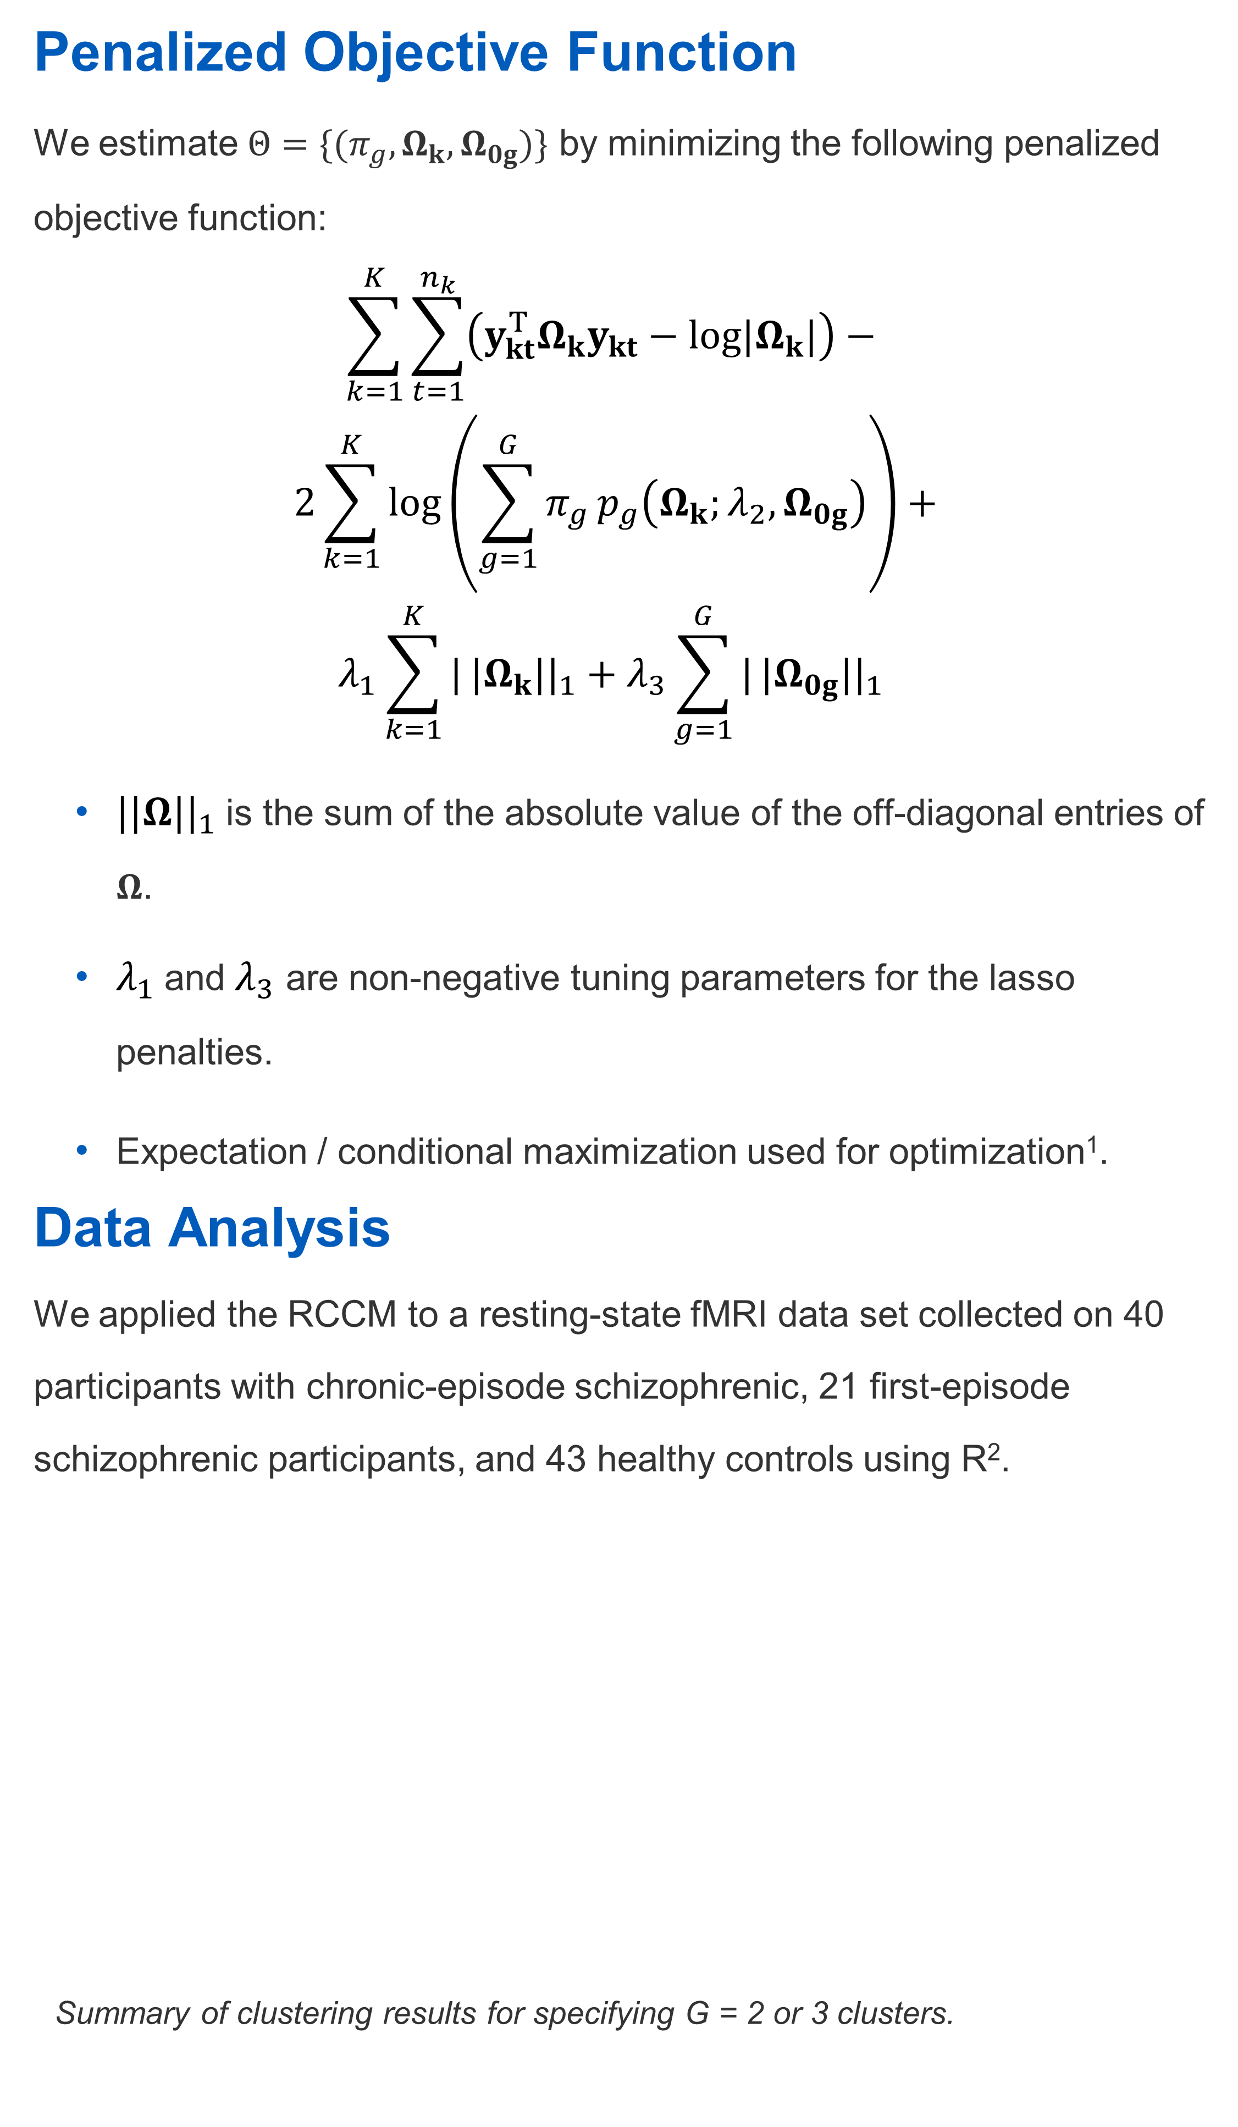
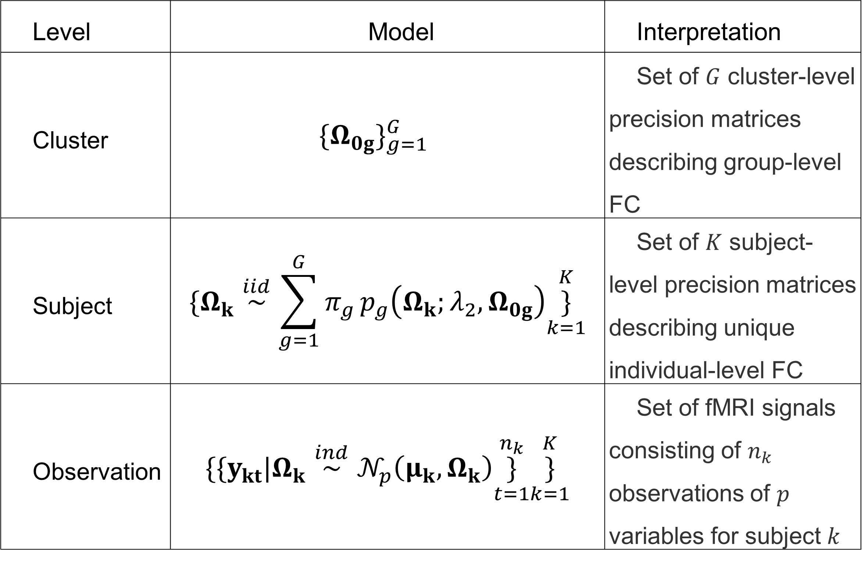

Penalized model-based clustering of fMRI data
Andrew DiLernia¹, Karina Quevedo², Jazmin Camchong², Kelvin Lim², Wei Pan³, and Lin Zhang³
¹Department of Statistics, Grand Valley State University, ²Division of Biostatistics, University of Minnesota
³Department of Psychiatry, University of Minnesota
Introduction
Functional connectivity (FC) is important for understanding neurodegenerative diseases and psychiatric disorders.
FC-based clustering of multi-subject fMRI data can inform physicians about patient diagnoses.
We propose a random covariance clustering model (RCCM) to cluster individuals based on FC, estimate individual FC networks, and to infer shared network features.
Hierarchical Model
$y_{kt}$ is a $p$-dimensional Gaussian random variable with mean vector $μ_{k}$ and covariance matrix $Σ_{k}$.
$Ω_{k}={Σ_{k}}^{−1}$ follows a mixture distribution, with $p_{g}\left(Ω_{k};λ_{2},Ω_{0g}\right)$ being the PDF of a Wishart random matrix with degrees of freedom $λ_{2}$ and mean matrix $Ω_{0g}$.
$π_{g}$ represents the proportion of subjects belonging to cluster g.
Penalized Objective Function
We estimate $Θ=\{(π_{g},Ω_{k},Ω_{0g})\}$ by minimizing the following penalized objective function:
$$\sum_{k=1}^{K}{\sum_{t=1}^{n_{k}}{\left(y_{kt}^{T}Ω_{k}y_{kt}−log|Ω_{k}|\right)−}}$$
$$2\sum_{k=1}^{K}{log}\left(\sum_{g=1}^{G}{π_{g}}p_{g}\left(Ω_{k};λ_{2},Ω_{0g}\right)\right)+$$
$$λ_{1}\sum_{k=1}^{K}{|}|Ω_{k}||_{1}+λ_{3}\sum_{g=1}^{G}{|}|Ω_{0g}||_{1}$$
$||Ω||_{1}$ is the sum of the absolute value of the off-diagonal entries of $Ω$.
$λ_{1}$and $λ_{3}$ are non-negative tuning parameters for the lasso penalties.
Expectation / conditional maximization used for optimization¹.
Data Analysis
We applied the RCCM to a resting-state fMRI data set collected on 40 participants with chronic-episode schizophrenic, 21 first-episode schizophrenic participants, and 43 healthy controls using R².
Summary of clustering results for specifying G = 2 or 3 clusters.
Variability in edge presence with 0 indicating perfect agreement in edge presence within a cluster, and values closer to 0.25 indicating more variability.
Estimated FC networks of the inferior and superior parietal lobules obtained using RCCM specifying G = 2 or 3 clusters for the top and bottom rows respectively.
Discussion
Found some evidence to support the disconnection hypothesis among the majority schizophrenic group.
Could be extended to account for autocorrelation or dynamic FC.
R Package
An R package implementing the RCCM is publicly available on GitHub: https://github.com/dilernia/rccm
References
Meng, X., and D. B. Rubin. 1993. “Maximum Likelihood Estimation via the ECM Algorithm: A General Framework.” Biometrika 80 (2): 267. https://doi.org/10.2307/2337198.
R Core Team. 2021. R: A Language and Environment for Statistical Computing. Vienna, Austria: R Foundation for Statistical Computing. https://www.R-project.org/.
Level | Model | Interpretation
Cluster | $$\{Ω_{0g}\}_{g=1}^{G}$$ | Set of $G$ cluster-level precision matrices describing group-level FC
Subject | $$\{Ω_{k}\overset{iid}{∼}\sum_{g=1}^{G}{π_{g}}p_{g}\left(Ω_{k};λ_{2},Ω_{0g}\right)\underset{k=1}{\overset{K}{\}}}$$ | Set of $K$ subject-level precision matrices describing unique individual-level FC
Observation | $$\{\{y_{kt}|Ω_{k}\overset{ind}{∼}𝒩_{p}\left(μ_{k},Ω_{k}\right)\underset{t=1}{\overset{n_{k}}{\}}}\underset{k=1}{\overset{K}{\}}}$$ | Set of fMRI signals consisting of $n_{k}$ observations of $p$ variables for subject $k$
G | Group | Control | 1st Episode | Chronic
2 | A | 23 (53.5%) | 14 (66.7%) | 30 (75.0%)
 | B | 20 (46.5%) | 7 (33.3%) | 10 (25.0%)
3 | C | 21 (48.8%) | 12 (57.1%) | 28 (70.0%)
 | D | 10 (23.3%) | 6 (28.6%) | 8 (20.0%)
 | E | 12 (27.9%) | 3 (14.3%) | 4 (10.0%)
Department of Statistics Grand Valley State University
gvsu.edu

